Slide 1
Introduction to Python & Fundamentals
Presenter Kashif Shoukat
Notes:
Hello and welcome to this Python 3 Introduction Training Session, by the end of this session. we'll have a initial level deep understanding of all the main concepts and big picture overview of
Everything you need to get started with python. python is the most popular programming language out there and is used for so many different industries like web development data science
machine learning or generally for writing automation programs to automate repetitive tasks so learning python is definitely a good idea
Before we dive into the exciting world of Python, let's take a moment to get to know each other and discover your interests and experiences. I'd love to hear a little bit about each of you and you're understanding with Python or any other programming language. Let's make this introduction fun and comfortable! . Don't worry if you're completely new to programming – we're all here to learn together!
So I will start first,
Hello Everone, my name is Kashif Shoukat.
With almost 11 years of experience in cloud services and automation, I am a motivated and mission-driven professional who specializes in Systems Architecture, IT Security, DevOps, and Automation, as well as Build/Release Engineering. I have successfully delivered numerous projects across various industries, including assessments and migrations from on-premises to the cloud for multiple clients. My passion lies in utilizing my skills and knowledge to help organizations achieve their objectives.
I hold a Bachelor's degree in Computer Science and possess several professional certifications such as AWS, Azure, Terraform Associate, and Ethical Hacking, which keep me abreast of the latest technologies and best practices in the industry. Moreover, I am currently pursuing Kubernetes certification to further augment my skills.
I love to do work with open-source tools and technologies and love to do automation.
Alright.
Other thing is that, after every 45 Minutes, we will try to take 10 to 15 minutes break for mental refreshment.

Slide 2
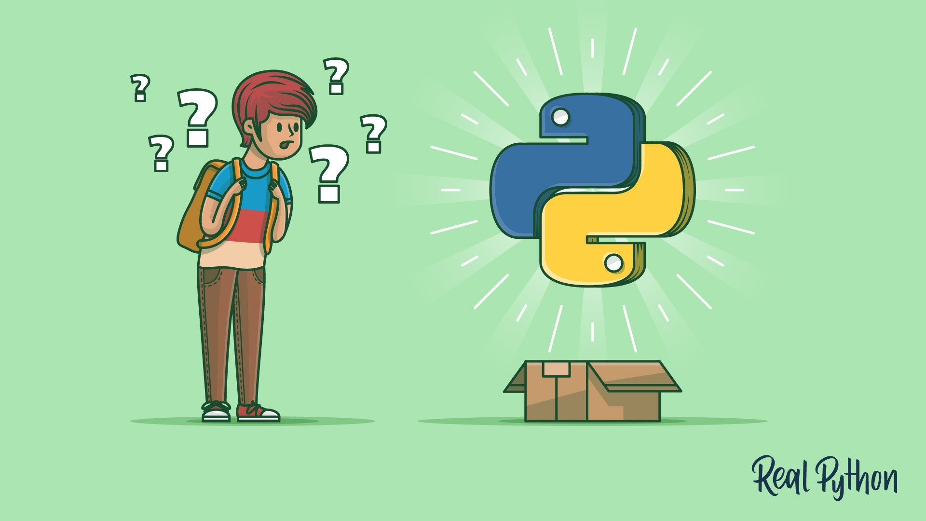
Today Agenda
Basic Building blocks of Programming
Python Features & uses of Python
Basic Operations – Assignment, Numbers and Strings
Loops
Errors & Exception Handling
Labs and Discussions
Python data types
Notes:
let me give you a short overview of all the topics that I'll cover in this course after giving a short introduction to python
we will start with the basic building blocks of programming the most important data types like strings numbers lists sets dictionaries Boolean data types etc.
and how to work with them learn about variables and functions and why we need them write a program that take user input
and learn how to validate the user input using conditionals error handling with try accept and also learn loops with while and for loops and again why we actually need them
You will learn all these concepts with hands-on examples as a next step

Slide 3
What is Programming
Programming is the process of giving instructions to a computer to perform tasks or solve problems. It involves writing a set of step-by-step commands in a programming language that the computer can understand and execute.
Notes:
Have you ever wondered how computers understand what we want them to do?
Let's explore this amazing world together and learn how we can tell computers what to do.
Imagine you have a special Robot friend called Tom. This friend is a computer, and you can make it do cool things! But how?
By giving it a set of instructions, just like you would tell a friend what to do.
Programming is like creating a secret language that computers understand. It's a way to talk to them and give them step-by-step directions. You can think of it as a recipe for the computer to follow.
For example, let's say you want to make a sandwich. You would tell Tom , "Get two pieces of bread. Put cheese and tomatoes on one piece. Then, place the other piece on top." In programming, we write similar instructions, like "Get bread, add cheese and tomatoes, then put another piece on top."
But here's the exciting part: with programming, we can do much more than make sandwiches! We can create games, build websites, and many more. It's like having a super power to make the computer or machines do incredible things.
When you start learning programming, you begin with simple tasks and slowly move on to more exciting projects. You learn special words and rules to make the computer understand you. It's like solving puzzles and figuring out the best way to get things done.
Programming helps us think logically and solve problems. We learn to break big tasks into smaller steps, just like putting together puzzle pieces. It's a creative and fun way to make things happen on the computer.
So, if you're curious about programming, get ready for this adventure! Start with easy programmers, watch simple tutorials, and ask questions when you need help. Remember, the most important thing is to have fun and enjoy the journey.
Who knows, maybe one day you'll create your own game or make something incredible with programming. The possibilities are endless when you have the power to give instructions to computers and machines.
So, let's dive into the exciting world of learning programming language and see what wonders we can create together.

Slide 4
Key things to remember
Syntax
Readability
Practice
Problem soloing
Debugging
Documentation
Notes:
When you're working with Python or any programming language, there are a few important rules to remember. These rules will help you write code that works correctly:
Follow the instructions: Just like following the steps of a recipe, you need to follow the rules of Python. Pay attention to things like spacing, using colons, and using the right words.
Make it easy to understand: Write your code in a way that is easy to read and understand. Use clear names for things and add notes to explain complicated parts. This way, you and others can understand and change the code later if needed.
Practice makes perfect: The more you practice writing code, the better you'll get at it. Try solving puzzles or small projects to get better at programming.
Break down problems: When you're faced with a big problem, break it down into smaller parts. Figure out what you need to do step by step, and then write the code for each step.
Fixing mistakes: It's normal to make mistakes in programming. When something doesn't work, read the error messages carefully, check for typos or errors, and use print statements to understand what's going wrong.
Use available resources: There are many books, websites, and communities that can help you learn Python. Take advantage of them and ask questions when you need help.
Be creative and try new things: Programming is like being an inventor. You can come up with new ideas and try different ways to solve problems. Don't be afraid to be creative and experiment.
Remember, learning programming takes time and practice. Enjoy the journey, stay curious, and don't give up. With Python, you can create amazing things!

Slide 5
Python Introduction
Python is simple, easy to learn, powerful, high level and object-oriented programming & interpreted scripting language.
Developed in the late 1980s by Guido van Rossum at the National Research Institute for Mathematics and Computer Science in the Netherlands
Notes:
So what is Python . We have quiet simple definition. But
Let me tell you a story about Python, a special programming language. Python is like a magical tool that helps people communicate with computers or machine. It's known for being simple, easy to learn, and powerful.
Imagine you have a big castle with many rooms, and each room has a different task. Python is like a smart guide that helps you navigate through these rooms and get things done. It understands your instructions in a language that is similar to how we talk, making it easier for you to give commands to the computer.
Python is popular because it doesn't get caught up in complicated details. It's like having a wise friend who simplifies things for you. You can focus on solving problems and creating amazing things without getting overwhelmed by technical complexities.
Another amazing thing about Python is that it works quickly. You don't have to wait long for your instructions to be understood. Python can interpret your commands right away, like a magician performing tricks in real-time.
Python also believes in teamwork. It encourages you to break down big tasks into smaller parts, just like building blocks, and then put them together to create something fantastic. It's like having a group of friendly helpers who work together to accomplish a big project.
Python is versatile too. It can be used in many different fields, like building websites, analyzing data, creating games, and even exploring scientific discoveries. It's like a superpower that opens doors to various possibilities.
And the best part? Python has a big community of people who love to share their knowledge and help each other. They create special tools and resources that make coding even more fun and exciting.
So, if you ever want to learn programming and have fun with computers, Python will be your loyal companion. It will guide you through the magical world of coding and help you unlock your creativity. With Python, you can turn your ideas into reality and become a true coding wizard.
Now, here comes the fun part! Did you know that Python was invented during the Christmas holidays? a guy named Guido, who was a computer programmer, He wanted to create a new programming language that was easy to understand and fun to use. So, Guido started writing the first lines of Python code!
Guido wanted to make programming feel like writing in plain English, so he created a language that had simple and easy-to-read instructions.
With Python, we can create our own digital wonders and have fun while doing it. Who knows, maybe one day you'll invent something incredible with Python, just like Guido did during his cozy Christmas holidays!

Slide 6
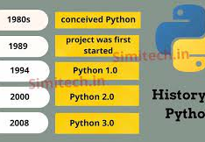
Python Versions
Technology is constantly changing. That the great thing about our industry and the frustrating thing about our industry.
In Python, there was a bit of a riff when the language went from version 2.x to 3.x. The debate is mostly over but know that some popular packages were slow to embrace Python 3 and developers were forced to choose between versions.
Notes:
Python has an interesting history! It all started back in 1991 when a smart person named Guido created Python.
But as time went on, the creators of Python realized that they could make it even better. So, they made some changes and released Python 3. It had new features and improvements that made it more powerful and efficient.
However, there was a little challenge. Some programs written in Python 2 couldn't work exactly the same way in Python 3. It was like changing the rules of a game, and some people found it difficult to update their old programs.
To help everyone transition smoothly, both Python 2 and Python 3 were available for a while. But eventually, the Python community decided that it's best to focus on the newer version, Python 3, because it had more advancements and improvements.
So, if you're starting to learn Python now, it's recommended to use Python 3. It's like getting the latest version of your favorite video game, with better graphics and new features to enjoy.

Slide 7
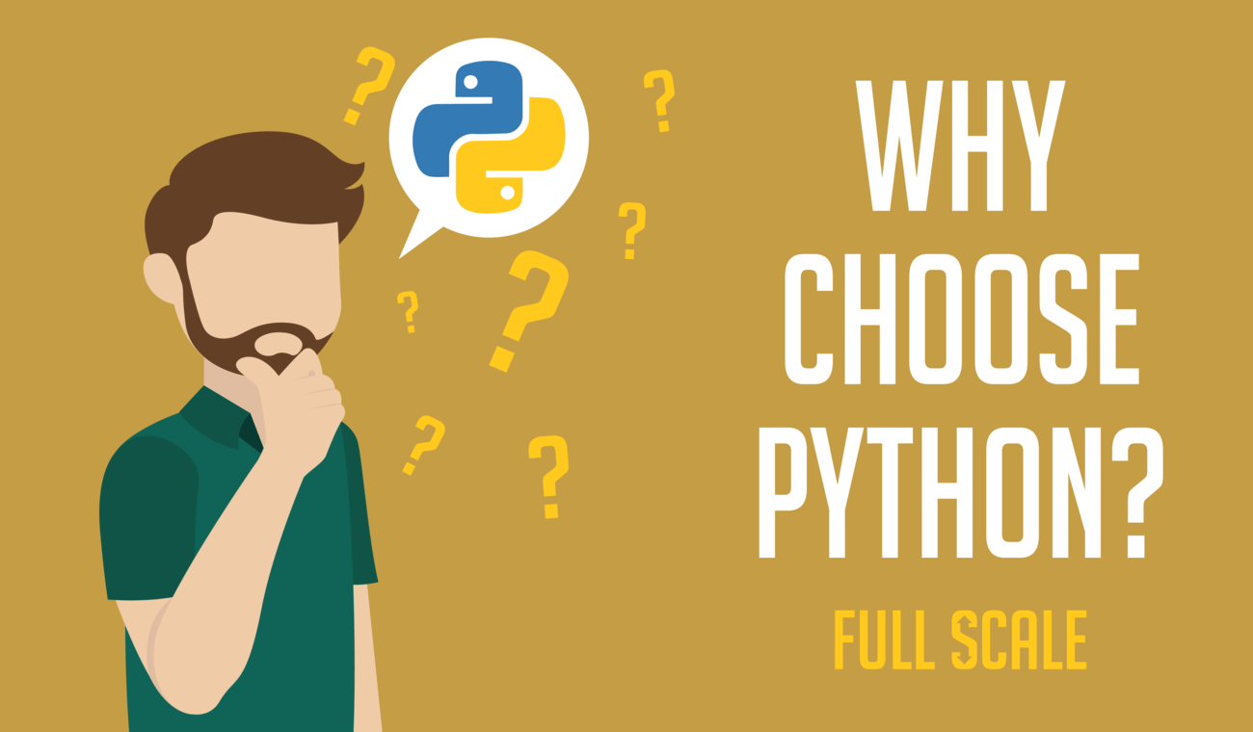
Why Choose Python?
Python is Popular
Python is Interpreted
Python is Free
Python is Portable
Python is Simple
Notes:
According to recent survey, as of October 2022, Python overtook Java and C as the most popular language. Imagine you are learning a new game, and it's always more fun when you can play with friends and ask for help when needed. Python is like that popular game with a big community of players who can help you along the way. making your learning journey more enjoyable and supported
Python is like that helpful friend who can understand your code without needing to compile it first or Think about having a friend who can understand and follow your instructions right away, without any extra steps.
Imagine you want to learn something new, but it costs a lot of money to get started. Python is like a special gift that you can use without spending any money. This makes it accessible for everyone, regardless of their financial resources, so you can learn and explore without any barriers.
Think about wanting to play your favorite game anywhere you go, whether it's at home, in a park, or on a road trip.
Imagine learning something new, and it feels overwhelming and confusing specially when you are going to start your new programming language. Python is like a language that speaks in simple and clear terms, so it's easier to understand. This simplicity makes it less intimidating to get started and helps you focus on the fun part of coding, like solving puzzles and creating exciting programs.
In short, By choosing Python, you can enjoy the benefits of a supportive community, instant feedback, no cost, portability, and a simple language that makes learning to code more enjoyable.

Slide 8
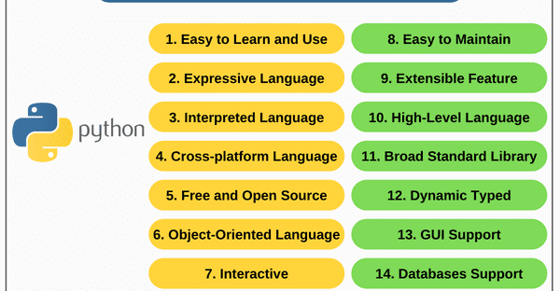
Python Features
Notes:
Easy to Learn and Use: Python has a simple and readable syntax, making it easier to understand and write code. It's like learning a new language that is straightforward to grasp and use. For example, imagine learning Python is similar to learning how to write clear and concise instructions for a robot.
Expressive Language: Python allows you to express your ideas and solve problems in a concise and natural way. It's like speaking in plain English to communicate with the computer. For instance, if you want to say "Hello" to the computer in Python, you simply write print("Hello").
Interpreted Language: Python is an interpreted language, which means you can write code and see the results immediately without the need for a separate compilation step. It's like having a personal translator who can instantly understand and execute your instructions.
Cross-platform Language: Python can run on different operating systems like Windows, Linux, and macOS. It's like having a versatile tool that works seamlessly on various devices, It's like having a magic pen that can draw on any kind of paper or canvas.
Free and Open Source: Python is like a gift that you can use without paying any money. It's also like a recipe that you can change and share with your friends, so everyone can cook their favorite dish.
Object-Oriented Language: Python lets you build things by combining small blocks called objects, just like building with LEGO bricks. You can create your own objects and use them to make bigger and cooler things.
Interactive: Python provides an interactive mode where you can write code and get immediate feedback. It's like having a conversation with the computer, where you can ask questions and get instant answers.
Easy to Maintain: Python emphasizes code readability, making it easier to understand and maintain your code over time. It's like keeping your room clean and organized, so you can find things quickly and make changes easily.
Extensible Feature: Python allows you to extend its functionality by incorporating additional libraries and modules. It's like adding new tools to your toolbox to tackle different tasks efficiently.
High-Level Language: Python is like using a magic wand that understands your commands without needing to know all the complicated details. You can focus on what you want to achieve instead of worrying about the nitty-gritty stuff.
Broad Standard Library: Python comes with lots of pre-made pieces that you can use to build your own creations, just like having a big box of building blocks. It's like having a head start instead of starting from scratch every time.
Dynamic Typed Language: Python is dynamically typed, meaning you don't need to explicitly declare variable types. It's like having a magic container that automatically adjusts its contents based on what you put inside.
GUI Programming Support: Python has libraries that enable graphical user interface (GUI) programming, allowing you to create visually appealing applications with buttons, windows, and other interactive elements. It's like designing and building your own user-friendly video game.
Databases Support: Python has libraries to work with databases, allowing you to store and retrieve data efficiently. It's like having a smart diary that can remember and retrieve information for you whenever you need it.
Automation Tool: Python can be used as an automation tool to perform repetitive tasks automatically. It's like having a virtual assistant that can complete certain tasks for you, such as organizing files or sending emails.
Scalable: Python is scalable, which means it can handle small projects as well as large-scale applications used by millions of people. It's like a balloon that can expand to accommodate more air without bursting.

Slide 9
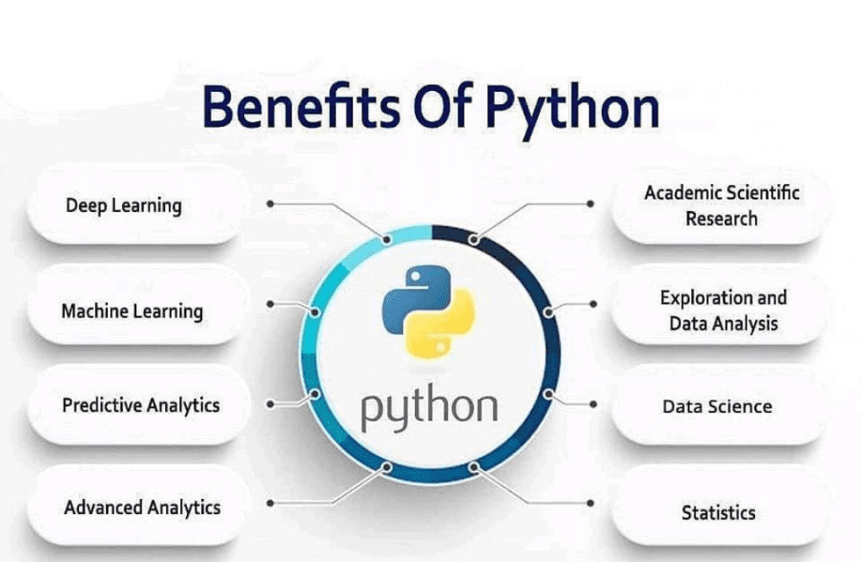
Benefits Of Python
Web and internet Development
Scientific and Numeric Computing
Eudcation
Games and 3D Graphics
Data Science
Notes:
Imagine being able to teach a computer to think and learn, just like a smart robot. With Python, you can do just that! You can build incredible machines that recognize faces, drive cars, or even predict the weather.
Python can help you uncover hidden patterns and secrets in big piles of data. It's like having a superpower to analyze information and make sense of it all. You can predict sports results, find patterns in numbers, or even analyze data for scientific research!
Python also loves to help you save time and make your life easier. It's like a helpful assistant that can automate repetitive tasks. You can use Python to automation your search like web scaper , or even control robots and drones. It's like having your own little helper that does things for you!
Python is one of the best programming languages for Automation in DevOps. DevOps teams use Python for automating repetitive tasks, infrastructure provisioning, and API-driven deployments. CI/CD workflows and much more.
Remember, Python is your magical companion that helps you turn dreams into reality.
Python Fits in Every Industry!
No matter which industry you work in, Python is the language that can be used almost everywhere! That's why it has become such a popular choice among programmers. Whether you're interested in technology, science, arts, or even business, Python is there to help you create amazing things.

Slide 10
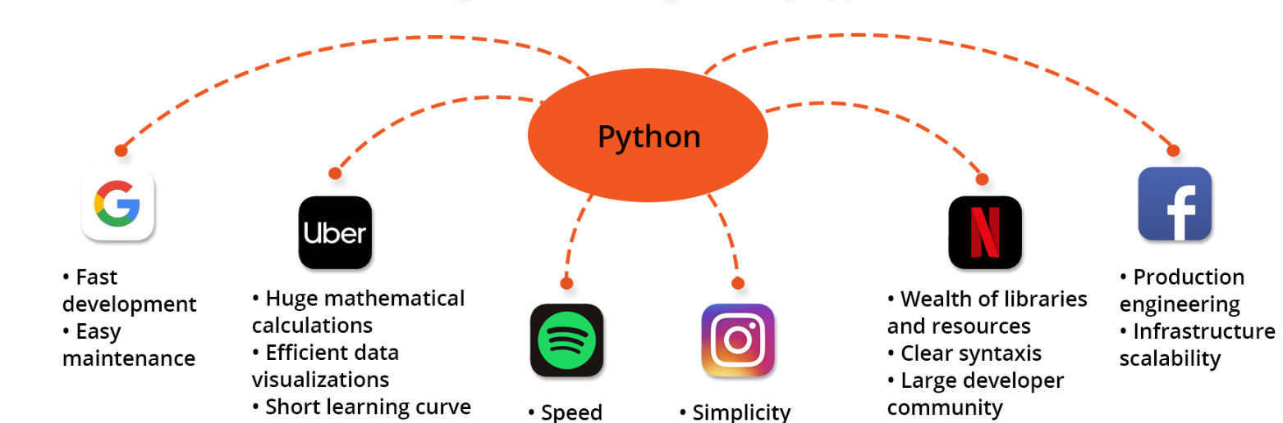
Top Apps Built With Python
Notes:
https://www.visartech.com/blog/python-application-for-business/
https://pypl.github.io/PYPL.html
One of the world’s biggest code hosting platforms, Github places Python on top of its PYPL Popularity index. This ranking is based on how often people search the Internet for coding tutorials. Obviously, there are reasons why they want to tap into Python app development. Other communities, such as Stack Overflow, are also placing Python on top of their rankings.
here’s an overview of the different kinds of applications developed with Python. Some of these names may include your long-term favorites.
Instagram: Initially, the world-renown image-sharing network was built with Python as a simple website on the Django framework. Surely, since then the company’s tech stack has gotten more complex.
Simplicity is the reason why the Instagram tech team chose Python in the first place. Currently, as the pool of users extends, they are reaping the benefits of its scalability and efficiency

Slide 11
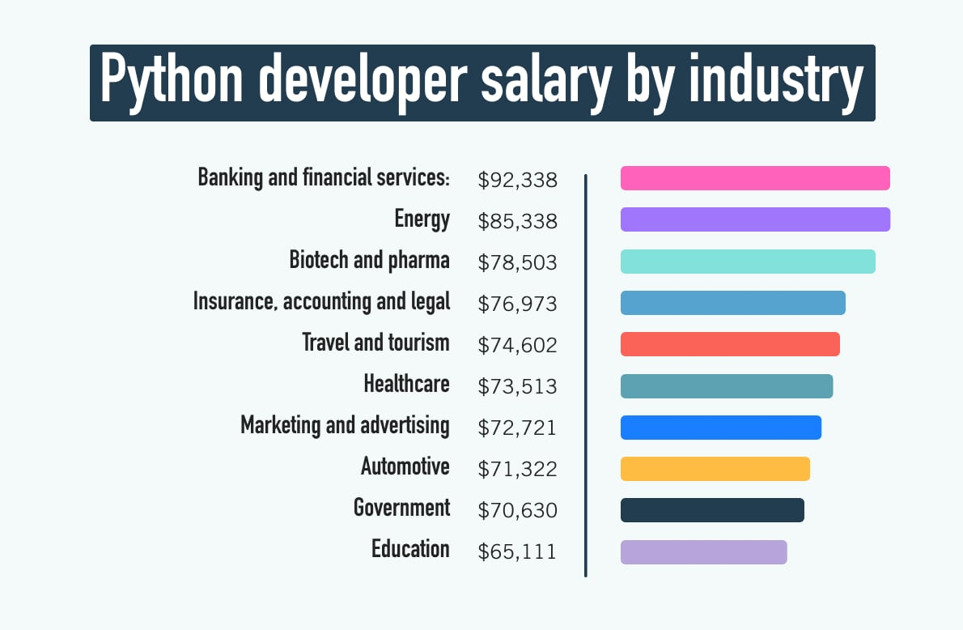
Career Opportunity in Python Are you looking for a skill that opens doors to exciting opportunities and a promising career?
Notes:
Learning Python can lead you to a world of endless possibilities and attractive job prospects.
One of the most appealing aspects of Python is its strong demand in the job market. Companies across various sectors are actively seeking Python developers, and this demand continues to grow rapidly. As a result, Python professionals enjoy a range of exciting career opportunities.
When it comes to salaries, Python developers are rewarded for their skills. With Python expertise, you can expect a competitive salary.
Remember, with Python, you're not just learning a programming language; you're unlocking a world of possibilities and setting yourself up for success in the dynamic and ever-evolving tech industry.

Slide 12
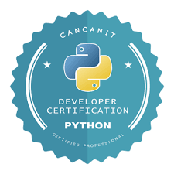
What certifications does the Python Institute offer?
The OpenEDG Python Institute offers a wide selection of general-track and specific-track certifications. The general track is made up of three certifications:
PCEP™ – Certified Entry-Level Python Programmer certification, for beginners
PCAP™ – Certified Associate in Python Programming certification, for intermediate-level Python programmers
PCPP1™ – Certified Professional in Python Programming 1 certification, for advanced programmers
Notes:
https://www.linkedin.com/pulse/complete-path-python-certification-logical-operations/
https://pythoninstitute.org/certification-tracks
The Python Institute offers a range of certifications that validate your Python programming skills and knowledge. These certifications are recognized worldwide and are highly regarded in the industry.
Some of the certifications offered are:
PCAP (Python Certified Associate Programmer): This entry-level certification verifies your fundamental understanding of Python programming concepts, syntax, and problem-solving skills. Then we have
PCPP (Python Certified Professional Programmer): This certification is for experienced Python programmers who have proficiency in advanced programming techniques, software development, and code optimization.
PCAP-31-02: This certification focuses on Python programming for networking, covering topics such as socket programming, network protocols, and web services.
PCAP-31-03: This certification specializes in Python programming for IoT (Internet of Things) applications, including working with sensors, actuators, and data processing.
PCAP-31-04: This certification is tailored for Python programming in financial markets, covering topics like algorithmic trading, data analysis, and financial modeling.
By earning these certifications, you can showcase your expertise and credibility as a Python programmer, enhancing your job prospects and opening doors to exciting career opportunities in various industries.

Slide 13
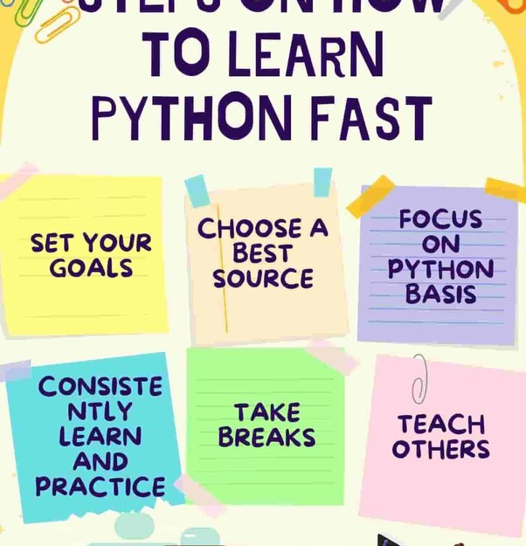
How to learn Python quickly and efficiently
Start with a good tutorial or book: There are many good tutorials and books available that can help you get started with Python. Look for resources that are geared towards beginners and that take a gradual, step-by-step approach to teaching the language.
Practice, practice, practice: The best way to learn Python is to write code. Work through exercises and challenges, and try building small projects to get a feel for the language.
Take breaks and review your progress: Learning a programming language can be challenging, and it is important to take breaks and review your progress regularly. This can help you stay motivated and avoid burnout.
Get help when you need it: Don't be afraid to ask for help when you are stuck or don't understand something. There are many online communities and forums where you can get help from other Python developers.
Learn about key concepts: As you learn Python, try to get a deep understanding of key concepts such as data types, variables, control structures, and object-oriented programming. This will help you become a more effective and efficient programmer.
Notes:
https://www.linkedin.com/pulse/complete-path-python-certification-logical-operations/
https://pythoninstitute.org/certification-tracks
Explain it – how they can use it.
https://ai-cg.gundegadekena.repl.co/generate

Slide 14
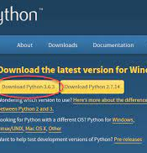
Installation Method of Python and available IDEs
Official Python Distribution: You can get Python directly from the official Python website. It's like getting the basic version of Python with all the important parts.
Package Managers: These make it easier to install and manage Python and its extra features. The most popular one is called pip. It's like a special tool that helps you add and update Python features easily. Other package managers like Anaconda, Miniconda, and Homebrew are good for specific things like science and data analysis.
Integrated Development Environments (IDEs): IDEs are special computer programs that give you a complete space for writing Python code. They have tools like code editors, debuggers, and project managers. Some well-known IDEs for Python are PyCharm, Visual Studio Code, Atom, and IDLE (which is included with Python).
Online Code Editors: If you don't want to install anything on your computer, you can use online code editors. They let you write and run Python code right in your web browser. Examples of online code editors are Replit, Google Colab, and Jupyter Notebook (you can find them on websites like Azure Notebooks and Google Colab).
Notes:
There are a few different options available for installing Python, depending on your specific needs and preferences. Here are the main options:
Official Python Distribution: You can download and install Python directly from the official Python website (https://www.python.org/downloads/). This option provides you with the standard Python distribution, which includes the core Python interpreter and essential modules.
Package Managers: Package managers simplify the installation and management of Python and its packages. The most commonly used package manager for Python is pip. Pip comes pre-installed with most Python distributions and allows you to install, upgrade, and manage Python packages easily
Integrated Development Environments (IDEs): IDEs are software applications that provide a comprehensive coding environment for Python development. They often include features such as code editors, debugging tools, and project management capabilities. Some popular Python-specific IDEs include PyCharm, Visual Studio Code, Atom, and IDLE (which comes bundled with Python).
Online Code Editors: If you prefer not to install anything locally, you can use online code editors that allow you to write and run Python code directly in your web browser. Examples of online code editors include Replit, Google Colab, and Jupyter Notebook (hosted on platforms like Azure Notebooks and Google Colab).
It's important to note that the specific options available to you may vary depending on your operating system (Windows, macOS, Linux) and your specific needs as a programmer.
Ultimately, the choice of installation method depends on your comfort level, the projects you plan to work on, and any specific requirements you may have. Exploring and trying different options will help you find the one that suits you best.
https://www.infoworld.com/article/3530140/how-to-install-python-the-smart-way.html

Slide 15
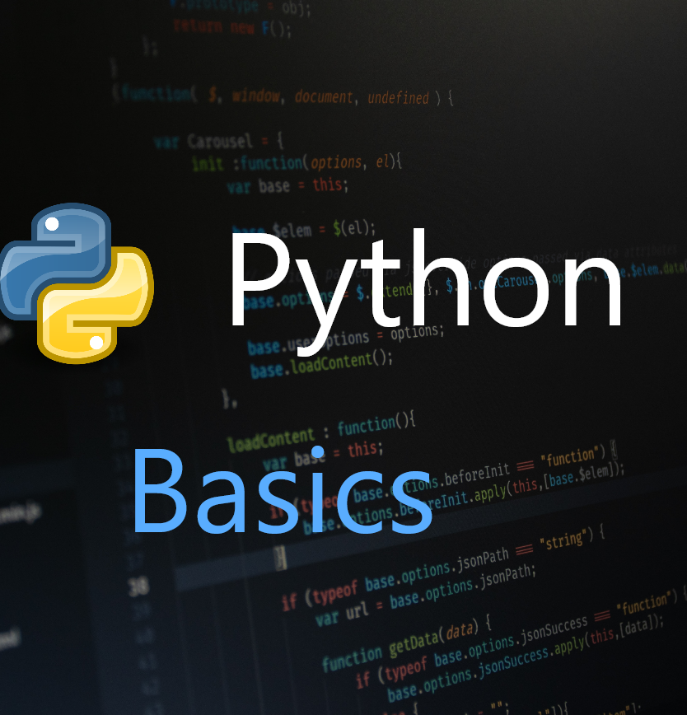
The Basic Python Syntax
Comments
Variables
Keywords
Built-in data types
Conditional statements
Loops
Functions
Notes:
https://realpython.com/python-first-steps/
https://data36.com/python-syntax-essentials-and-best-practices/
In this slide, ,I will try to explain the basic of pythons and its syntax
Again, Imagine you have a robot friend named TOM. TOM is super helpful and can do many cool things, but it only understands Python language. To communicate effectively with TOM, we need to learn the basic Python syntax. Don't worry, it's going to be fun!
Agenda:
Comments: Adding notes for ourselves and others to understand our code.
Variables: Giving names to things we want to remember and use later.
Keywords: Special words that have special meanings in Python.
Built-in Data Types: Different kinds of information we can work with.
Conditional Statements: Making decisions for TOM based on certain conditions.
Loops: Repeating actions to make TOM do things over and over again.
I will explain all these items in more details shortly in next upcoming slides. So stay tune.

Slide 16
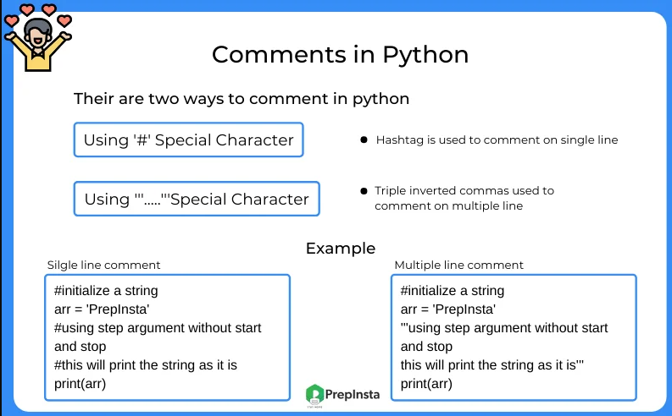
What is comment and do in Python?
Notes:
https://realpython.com/python-first-steps/
https://prepinsta.com/python/comments-in-python/
Comments are pieces of text that live in your code but are ignored by the Python interpreter as it executes the code. You can use comments to describe the code so that you and other developers can quickly understand what the code does or why the code is written in a given way. To write a comment in Python, just add a hash mark (#) before your comment text:
Now might be you have question in your mind ? Why I have to use and add comments rights ?
Advantages of using Comments in Code
Some advantages of using comments in your code are as follows:
Makes the code readable
Make your code easy to understand
Separate your functions and methods in a better way
Even sometime if you want to disable specific piece of code during testing and debugging. You can use comments to disable specific part of it and can continue tes
ting etc.

Slide 17
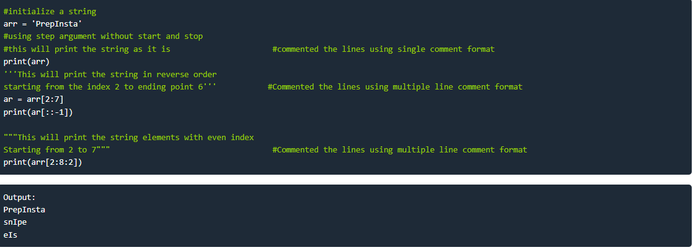
Example Code for Comments in Python
Notes:
https://realpython.com/python-first-steps/
https://prepinsta.com/python/comments-in-python/
Comments are pieces of text that live in your code but are ignored by the Python interpreter as it executes the code. You can use comments to describe the code so that you and other developers can quickly understand what the code does or why the code is written in a given way. To write a comment in Python, just add a hash mark (#) before your comment text:
Advantages of using Comments in Code
Some advantages of usding comments in your code are as follows:
Makes the code readable
Make your code easy to understand
Saperate your functions and methords in a better way

Slide 18
Example Code for Comments in Python
Notes:
https://realpython.com/python-first-steps/
https://prepinsta.com/python/comments-in-python/
Comments are pieces of text that live in your code but are ignored by the Python interpreter as it executes the code. You can use comments to describe the code so that you and other developers can quickly understand what the code does or why the code is written in a given way. To write a comment in Python, just add a hash mark (#) before your comment text:
Advantages of using Comments in Code
Some advantages of usding comments in your code are as follows:
Makes the code readable
Make your code easy to understand
Separate your functions and methords in a better way
Even if you want to disable specific piece of code then you can also disable it.
We will do all this in practical lab sessions shortly.

Slide 19
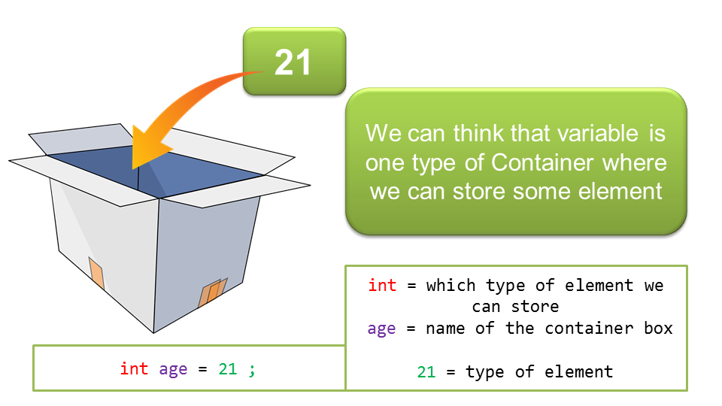
What is Variable
Notes:
What are Variables?
Think of variables as labeled boxes where you can put different things. Each box has a name (the variable's name) and can hold a specific type of information, such as numbers, text, or even more complex data.

Slide 20

Local vs Global Variables
# Global variable
name = "John"
def greet():
# Local variable
message = "Hello"
print(message + ", " + name)
greet() # Output: Hello, John
print(name) # Output: John
print(message) # This will give an error because 'message' is a local variable and is not accessible outside the 'greet' function.
Notes:
Now, let's talk about local and global variables:
Local Variables: Local variables are created and used within a specific part of your code, such as a function or a block of code inside curly braces ({}). These variables are only accessible within that specific part of the code where they are defined. Once you exit that part of the code, the local variables are no longer accessible. They are temporary and exist only as long as the function or block of code is running. This means that different functions or blocks of code can have variables with the same name without conflicting with each other.
Global Variables: Global variables are defined outside of any specific function or block of code, usually at the top of your program. These variables are accessible throughout your entire code, meaning they can be used in any part of your program, including inside functions or blocks of code. Global variables have a global scope, meaning they are available from the point of their definition until the end of the program. If you modify the value of a global variable inside a function, the change will persist outside the function as well.
Here's an example to understand the difference between local and global variables:
In this example, the variable "name" is a global variable because it is defined outside any function. It can be accessed both inside and outside the function
On the other hand, the variable "message" is a local variable because it is defined inside the "greet" function. It can only be accessed within that function and is not accessible outside.
I hope that clarifies the concept of variables and the difference between local and global variables in Python! Let me know if you have any further questions so far.

Slide 21
Variables
str
int
float
list
tuple
set
dict
str: A variable that holds a sequence of characters (text).
int: A variable that holds whole numbers (positive, negative, or zero).
float: A variable that holds numbers with decimal points.
list: A variable that holds an ordered collection of items.
tuple: A variable that holds an ordered collection of items that cannot be changed.
set: A variable that holds a collection of unique items (no duplicates).
dict: A variable that holds a collection of key-value pairs.
Notes:
str: A "str" is a type of data that represents text in Python. It's like a sentence or a word. For example, the word "hello" or the sentence "I love ice cream" are both "str" in Python.
int: An "int" is a type of data that represents whole numbers in Python. These are numbers without any fractions or decimals. For example, the numbers 5, 10, and 100 are all "int" in Python.
float: A "float" is a type of data that represents numbers with decimal points in Python. It's like a number that can have parts of a whole. For example, the numbers 3.14 or 2.5 are both "float" in Python.
list: A "list" is a way to store multiple pieces of information in a specific order. It's like a collection of items. For example, if you have a list of your favorite fruits, you can put apples, bananas, and oranges in the list. You can change the order or add or remove items from the list.
tuple: A "tuple" is similar to a list, but once you create it, you cannot change it. It's like a fixed list that you can't modify. For example, if you have a tuple with the days of the week, it will always have Monday, Tuesday, Wednesday, and so on, and you can't change it.
set: A "set" is a collection of unique items. It's like a bag of things, but each thing is different and there are no duplicates. For example, if you have a set of colors, you can put red, blue, and green in the set, but you can't have the same color more than once.
dict: A "dict" is short for dictionary. It's like a real-life dictionary where you can look up a word and find its definition. In Python, it's a collection of key-value pairs. For example, you can have a dictionary of names and ages, where the names are the keys and the ages are the values. You can look up a name and find the corresponding age.
Quesitons time ? – can some one explain me use case of each variable. Give me small example in which case you will use specific variable .
Let me give you use case examples for each variable type:
str: You can use a "str" variable to store a person's name, a message to be displayed on the screen, or a sentence in a story.
int: An "int" variable can be used to keep track of a person's age, count the number of books on a shelf, or represent the score in a game.
float: You can use a "float" variable to store the price of an item, calculate the average of a set of numbers, or represent measurements like the weight of an object.
list: A "list" variable can be used to store a shopping list, keep track of a to-do list, or store a collection of names of friends.
tuple: You can use a "tuple" variable to store the coordinates of a point on a map, represent a date (year, month, day), or hold the RGB values of a color.
set: A "set" variable can be used to store a unique list of words in a document, keep track of unique items in a game, or store a collection of unique usernames.
dict: A "dict" variable can be used to store a phonebook with names and phone numbers, represent a student's information with their name as the key and their grades as the values, or store a recipe with ingredients and quantities as key-value pairs.
These are just a few examples, and each variable type has many more potential use cases depending on the specific problem or scenario you are working on

Slide 22
Introduction to Python Data Types
Text Type | str
Numeric Type | int, float, complex
Sequence Type | list, tuple, range
Mapping Type | dict
Set Type | set, frozenset
Boolean Type | Bool
Binary Type | Bytes, bytearray, memoryview
Python data types – In programming a data type is an attribute of data which tells the interpreter how the programmer intends to use the data. Like most languages Python also supports data types. It includes data types such as numeric or non-numeric and boolean etc. Every different types of data works in their different way.
Notes:
https://realpython.com/python-first-steps/
https://prepinsta.com/python/comments-in-python/
In this slide, I will try to explain different data types in python.
Text Type (str): The "str" data type is used to store words or sentences in Python. It's like a way to keep track of text. For example, if you want to remember your name or write a message, you can use the "str" data type.
Numeric Types:
int: The "int" data type is for storing whole numbers like 5, 10, or 100. It's like counting things or keeping track of how many of something you have.
float: The "float" data type is for storing numbers with decimal points, like 3.14 or 0.5. It's like having parts of something, not just whole numbers.
complex: The "complex" data type is for representing special numbers that have two parts, a real part, and an imaginary part. It's like a number that has both a real value and a special part.
Sequence Types:
list: A "list" is like a collection of things that you can put in a particular order. It's like a shopping list or a list of your favorite toys. You can add new things, remove things, or change the order of things in a list.
tuple: A "tuple" is similar to a list, but once you create it, you can't change it. It's like having a fixed list of things that you can't modify. For example, if you have a list of your favorite colors, it will always be the same colors in the same order.
range: A "range" is a way to have a sequence of numbers. It's like counting from one number to another in steps. For example, you can have a range from 1 to 10, counting one by one.
Mapping Type:
dict: A "dict" is like a dictionary with words and their meanings. It's a way to store information where you can look up the meaning of a word quickly. In Python, you can have a dictionary with words (keys) and their meanings (values).
Set Types:
set: A "set" is like a collection of unique things. It's like having a bag of different toys, but there are no duplicate toys. Each toy in the set is different.
frozenset: A "frozenset" is similar to a set, but once you create it, you can't change it. It's like having a bag of toys that you can't add new toys to or take toys out from.
Boolean Type (bool): A "bool" can have only two values: True or False. It's like answering a yes or no question. You can use it to make decisions or check if something is true or false.
Binary Types:
Bytes: "Bytes" are used to store binary information, like pictures or computer data. It's like a special way to save and work with data that computers understand.
Bytearray: "Bytearray" is similar to bytes, but you can change it. It's like having a special box where you can put binary information and modify it if you need to.
Memoryview: "Memoryview" is a way to look at the information inside other objects, like bytes or arrays. It's like having special glasses that let you see inside things without changing them.
These data types help us store and work with different kinds of information in Python. They make it easier to organize and use data in our programs.
I hope this makes it easier for you to understand! Let me know if you have any more questions.

Slide 23
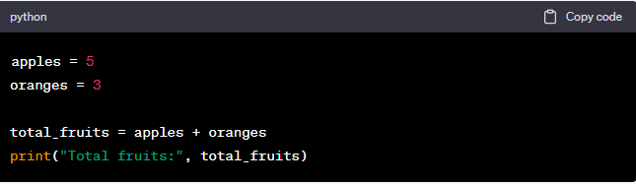
Integer variables – Numeric Data Type
Notes:
https://www.theengineeringprojects.com/2020/06/how-to-use-data-types-in-python.html
In this code, we have two variables: "apples" and "oranges," both holding integer values. We add the values together and store the result in the variable "total_fruits." Finally, we print the total number of fruits.
Integers are an essential part of programming, and they allow us to work with whole numbers in a precise way. As you explore more programming concepts and projects, you'll discover even more exciting ways to use integers.

Slide 24
Variable Labs
Lab 1: My Pet Requirements:
Now create a Python program that stores the name of your pet in a variable called "pet_name".
The program should then print a message that says "I have a pet named [pet_name]!".
Notes:
https://www.theengineeringprojects.com/2020/06/how-to-use-data-types-in-python.html
Now we are going to perform our first lab to understand how we can declare variable and assign values and then print results.

Slide 25
Variable Labs - Solution
Lab 1: My Pet Requirements:
Ask the kid to create a Python program that stores the name of their pet in a variable called "pet_name".
The program should then print a message that says "I have a pet named [pet_name]!".
# Lab 1: My Pet
pet_name = "Fluffy"
print("I have a pet named " + pet_name + "!")
Notes:
Explanation: In this lab, the we created a variable called "pet_name" and assigns pet's name to it. The print statement concatenates the variable value with a message to display the pet's name.
Key Takeaways:
Variables store values, such as names or numbers.
The value of a variable can be retrieved by using its name.

Slide 26
Variable Labs - Solution
Lab 2: My Pet Requirements:
Now create a Python program that stores the names of your three friends in separate variables.
The program should then print a message listing all the friends' names.
Notes:
Explanation: In this lab, the we created a variable called "pet_name" and assigns pet's name to it. The print statement concatenates the variable value with a message to display the pet's name.
Key Takeaways:
Variables store values, such as names or numbers.
The value of a variable can be retrieved by using its name.

Slide 27
Variable Labs - Solution
Lab 2: taking multiple variables and print them all in one statement:
Now create a Python program that stores the names of your three friends in separate variables.
The program should then print a message listing all the friends' names.
# Lab 3: My Friends
friend1 = "Alice"
friend2 = "Bob"
friend3 = "Charlie"
print("My friends are " + friend1 + ", " + friend2 + ", and " + friend3 + "!")
Notes:
Explanation: In this lab, the we created a variable called "pet_name" and assigns pet's name to it. The print statement concatenates the variable value with a message to display the pet's name.
Key Takeaways:
Variables store values, such as names or numbers.
The value of a variable can be retrieved by using its name.

Slide 28
Lab: Swap Variable Values
Requirements:
Create a Python program that swaps the values of two variables.
The program should take two variables, "a" and "b", with initial values.
After swapping, the values of "a" and "b" should be reversed.
Finally, the program should print the updated values of "a" and "b".
Notes:
# Lab: Swap Variable Values
a = 5
b = 10
print("Before swapping:")
print("a =", a)
print("b =", b)
# Swapping the values
temp = a
a = b
b = temp
print("After swapping:")
print("a =", a)
print("b =", b)
Explanation: In this lab, we introduce the concept of swapping variable values. Initially, "a" is assigned the value 5, and "b" is assigned the value 10. The program then uses a temporary variable, "temp", to store the value of "a". Next, "a" is assigned the value of "b", and "b" is assigned the value of "temp", effectively swapping their values. Finally, the updated values of "a" and "b" are printed.
Key Takeaways:
Swapping variable values involves using a temporary variable to hold one of the values temporarily.
The values of the variables can be exchanged by assigning them to each other.

Slide 29
Operators
3

Slide 30
Operators
Operators are used to perform operations on variables and values
Python divides the operators in the following groups:
Arithmetic operators
Assignment operators
Comparison operators
Logical operators
Identity operators
Membership operators
Bitwise operators
Notes:
An operator, in programming, is a symbol or a special set of characters that performs an operation on one or more values or variables to produce a result. Operators are used to manipulate data, perform calculations, compare values, and control the flow of program execution.
Operators can be categorized into different types based on their functionality and the types of values or variable they operate on. Some common types of operators include:
Arithmetic Operators: Perform mathematical operations like addition, subtraction, multiplication, division, etc.
Assignment Operators: Assign values to variables or modify the values of variables.
Comparison Operators: Compare two values and return a boolean result (True or False) based on the comparison.
Logical Operators: Combine boolean values or conditions and produce a boolean result based on logical operations like AND, OR, and NOT.
Identity Operators: Compare the identity of two objects to determine if they are the same or different.
Membership Operators: Check if a value is a member of a sequence or collection.
Bitwise Operators: Perform operations at the bit level, manipulating individual bits of binary values.
Operators play a vital role in programming languages as they enable us to perform various computations, make decisions, and control program flow. By understanding and using operators effectively, programmers can write efficient and expressive code to solve complex problems.

Slide 31
Arithmetic operators
Arithmetic operators are used with numeric values to perform common mathematical operations:
Operator | Name | Example
+ | Addition | x + y
- | Subtraction | x - y
* | Multiplication | x * y
/ | Division | x / y
% | Modulus | x % y
** | Exponentiation | x ** y
// | Floor division | x // y

Slide 32
Arithmetic operators
Arithmetic Operators Lab:
Problem: Write a program that takes two numbers as input from the user and calculates their sum.
Notes:
# Take input from the user
num1 = int(input("Enter the first number: "))
num2 = int(input("Enter the second number: "))
# Add the numbers using the addition operator
sum = num1 + num2
# Display the result
print("The sum is:", sum)

Slide 33
Assignment operators
are used to assign values to variables:
Operator | Example | Same As
= | x = 5 | x = 5
+= | x += 3 | x = x + 3
-= | x -= 3 | x = x – 3
*= | x *= 3 | x = x * 3
/= | x /= 3 | x = x / 3
%= | x %= 3 | x = x % 3
//= | x //= 3 | x = x // 3
**= | x **= 3 | x = x ** 3
&= | x &= 3 | x = x & 3
|= | x |= 3 | x = x | 3
^= | x ^= 3 | x = x ^ 3
>>= | x >>= 3 | x = x >> 3
<<= | x <<= 3 | x = x << 3

Slide 34

Assignment operators
Problem: Write a program to calculate and display the discounted price of a product.
Notes:
# Take input from the user
product_price = float(input("Enter the original price of the product: "))
discount_percentage = float(input("Enter the discount percentage: "))
# Calculate the discounted price using the assignment operator
discounted_price = product_price - (product_price * discount_percentage / 100)
# Display the discounted price
print("The discounted price is:", discounted_price)

Slide 35
Comparison operators
Comparison operators are used to compare two values:
Operator | Name | Example
== | Equal | x == y
!= | Not equal | x != y
> | Greater than | x > y
< | Less than | x < y
>= | Greater than or equal to | x >= y
<= | Less than or equal to | x <= y

Slide 36
Comparison operators
Problem: Problem: Write a program that compares two numbers and determines if the first number is greater than the second.
Notes:
# Take input from the user
num1 = int(input("Enter the first number: "))
num2 = int(input("Enter the second number: "))
# Compare the numbers using the greater than operator
if num1 > num2:
print("The first number is greater than the second number.")
else:
print("The first number is not greater than the second number.")

Slide 37
Logical operators
Logical operators are used to combine conditional statements:
Operator | Description | Example
and | Returns True if both statements are true | x < 5 and x < 10
or | Returns True if one of the statements is true | x < 5 or x < 4
not | Reverse the result, returns False if the result is true not | (x < 5 and x < 10)

Slide 38
Logical Operators
Problem: Write a program that checks if a number is positive and even
Notes:
# Take input from the user
num1 = int(input("Enter the first number: "))
num2 = int(input("Enter the second number: "))
# Compare the numbers using the greater than operator
if num1 > num2:
print("The first number is greater than the second number.")
else:
print("The first number is not greater than the second number.")

Slide 39
Identity operators
Identity operators are used to compare the objects, not if they are equal, but if they are actually the same object, with the same memory location:
Operator | Description | Example
is | Returns True if both variables are the same object | x is y
is not | Returns True if both variables are not the same object | x is not y

Slide 40
Membership operators
Membership operators are used to test if a sequence is presented in an object:
Operator | Description | Example
in | Returns True if a sequence with the specified value is present in the object | x in y
not in | Returns True if a sequence with the specified value is not present in the object | x not in y

Slide 41
Bitwise operators
Bitwise operators are used to compare (binary) numbers:
Operator | Name | Description
& | AND | Sets each bit to 1 if both bits are 1
| | OR | Sets each bit to 1 if one of two bits is 1
^ | XOR | Sets each bit to 1 if only one of two bits is 1
~ | NOT | Inverts all the bits
<< | Zero fill left shift | Shift left by pushing zeros in from the right and let the leftmost bits fall off
>> | Signed right shift | Shift right by pushing copies of the leftmost bit in from the left, and let the rightmost bits fall off

Slide 42
Operator precedence
The operator precedence in descending order, higher to lower:
Operator | Meaning
() | Parentheses
** | Exponent
+x, -x, ~x | Unary plus, Unary minus, Bitwise NOT
*, /, //, % | Multiplication, Division, Floor division, Modulus
+, - | Addition, Subtraction
<<, >> | Bitwise shift operators
& | Bitwise AND
^ | Bitwise XOR
| | Bitwise OR
==, !=, >, >=, <, <=, is, is not, in, not in | Comparisons, Identity, Membership operators
not | Logical NOT
and | Logical AND
or | Logical OR

Slide 43
Functions
4

Slide 44
Functions
A function is a block of code which only runs when it is called.
You can pass data, known as parameters, into a function.
A function can return data as a result.
Arguments:
Positional
Keyword
Default values
You can mix both fashions if you want - there is only one unbreakable rule:
positional arguments must be put before keyword arguments
def my_function(name):
print(“Good morning, “ + name)
my_function()
Notes:
A function is a block of code which only runs when it is called.
You can pass data, known as parameters, into a function.
A function can return data as a result.
To call a function, use the function name followed by parenthesis
Arbitrary Arguments, *args
If you do not know how many arguments that will be passed into your function, add a * before the parameter name in the function definition. *args is a tuple!
Keyword Arguments

Slide 45
Exercise 1. Function lab
Exercise 1. Temperature Converter
Exercise goal :
Write a program that converts temperature from Celsius to Fahrenheit and vice versa.
Instructions
Define two variables celsius and fahrenheit with initial values of 0.
Ask the user to enter a temperature in Celsius or Fahrenheit.
Convert the temperature to the other unit using the conversion formulas:
Celsius to Fahrenheit: fahrenheit = (celsius * 9/5) + 32
Fahrenheit to Celsius: celsius = (fahrenheit - 32) * 5/9
Print the converted temperature.
Self test instructions
Test the program by entering a temperature of 0°C. The output should be 32°F.
Test the program by entering a temperature of 32°F. The output should be 0°C.

Slide 46
Exercise 1. Temperature Converter
Exercise 1. Temperature Converter
Exercise goal :
Write a program that converts temperature from Celsius to Fahrenheit and vice versa.
Instructions
Define two variables celsius and fahrenheit with initial values of 0.
Ask the user to enter a temperature in Celsius or Fahrenheit.
Convert the temperature to the other unit using the conversion formulas:
Celsius to Fahrenheit: fahrenheit = (celsius * 9/5) + 32
Fahrenheit to Celsius: celsius = (fahrenheit - 32) * 5/9
Print the converted temperature.
Self test instructions
Test the program by entering a temperature of 0°C. The output should be 32°F.
Test the program by entering a temperature of 32°F. The output should be 0°C.

Slide 47
Exercise 1. Temperature Converter
Exercise 1. Temperature Converter
Exercise goal :
Write a program that converts temperature from Celsius to Fahrenheit and vice versa.
Instructions
Define two variables celsius and fahrenheit with initial values of 0.
Ask the user to enter a temperature in Celsius or Fahrenheit.
Convert the temperature to the other unit using the conversion formulas:
Celsius to Fahrenheit: fahrenheit = (celsius * 9/5) + 32
Fahrenheit to Celsius: celsius = (fahrenheit - 32) * 5/9
Print the converted temperature.
Self test instructions
Test the program by entering a temperature of 0°C. The output should be 32°F.
Test the program by entering a temperature of 32°F. The output should be 0°C.

